Slide 1
Day 3
Atrial and Ventricular Arrhythmias

Slide 3
Review
What makes a sinus rhythm sinus?
Rate
PR
PQRST
Origin?

Slide 4
Atrial Dysrhythmias
As name implies are formed in Atria.
Based on our knowledge already, what is going to be affected?
Caused by either of these reasons
Automaticity
Triggered Activity
ReEntry

Slide 5
Automaticity
Occurs in pacemaker cells
BEFORE SA node impulse
Can be
Incessant
Episodic
Normally Cause
PAC
A-Fib

Slide 6
Triggered Activity
Abnormal firing/electrical impulse
Repolarization
Pacemaker/Myocardial cells fire >+1 after stimulation
Causes
Atrial or Ventricular Beats
Beat
Runs
Ectopic

Slide 7
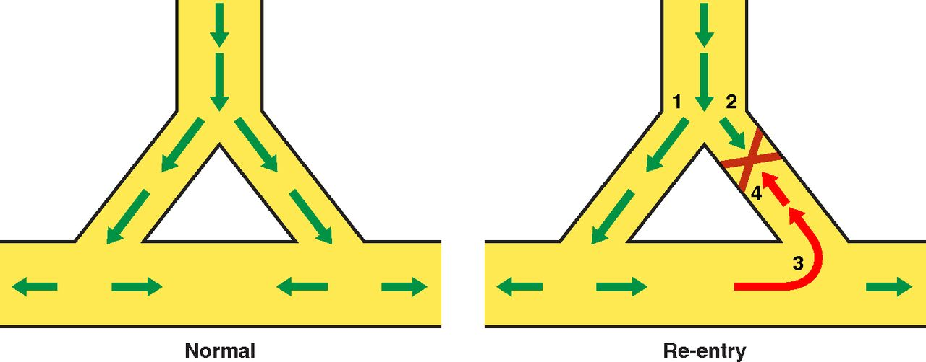
Reentry
Reactivation
Returning Impulse
Either
Conduction Circuit or Circular Conduction Pathway
Circuit Block
Delay Conduction
Causes
A-Flutter
AV Nodal Reentry Tach
AV Reentrant Tach

Slide 8
Atrial dysrhythmias
Most are non life threating
Common to see tachy ventricular rates
Fast heart rates
Increase or Decrease cardiac output?

Slide 9
Premature Atrial Complexes (PAC)
Normal P waves
Smooth and round
PAC come EARLY (Premature)
Either with or without complete complexes
P-on-T

Slide 10
Take a Look at this

Slide 11
Atrial Tachycardia
P close to T
Maybe “absent”

Slide 12
Atrial Flutter

Slide 13
Atrial Fibrillation

Slide 14
Break
10 Mins

Slide 15
Ventricular

Slide 16
Ventricular Problems
Problems arising from either
Bundle of HIS
R/L bundle branches
Perkinkie Fibers
What will be the problem on the ECG?
P Wave
QRS Complex
T Wave?

Slide 17
Ventricular Tachycardia (V-Tach)

Slide 18
Ventricular Flutter

Slide 19
Ventricular Fibrillation

Slide 20
Torsade De Pointe

Slide 21
Supraventricular Tachycardia (SVT)

